Slide 1
Introduction
Our presentation will focus on the five model of transport in Canada
The five models of transport in use in Canada which include
Motor carriers,
Railroads,
airlines,
Water carriers, and
pipelines.
Notes:
This presentation aims at describing five models of Canadian transport system
Motor carriers,
Railroads,
airlines,
Water carriers, and
pipelines.
The benefits and limitation of each model is discussed

Slide 2
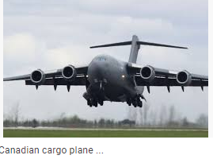
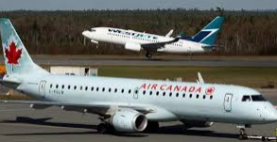
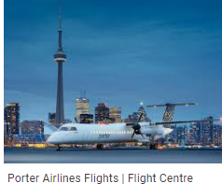
Canadian Airlines
Airlines
Canadian Airlines
Images of Canadian planes
Airline model of transport is where passengers and cargo are transported through the air using aircraft or airplanes.
In Canada, airlines serve a very critical role in the overall transportation mix.
Different airlines carry cargo and passengers locally within regions, nationally and internationally.

Slide 3
Benefits and limitations
Benefits
limitations
airport pollution due to noise from aircraft and its components.
Emission of pollutants from engines of the plane like
Nitrous oxide,
sulfur oxide, and carbon (iv) oxide
other volatile compounds affects air quality
Expensive
it has created employment opportunities for many individuals such
as pilots,
Air hostess,
Engineers,
mechanics
the source of revenue to the
it is the world's safest air transport
No recent incidents of accidents for the last decades.
Notes:
This slide is focusing on benefits and limitations of Canadian airline . The benefits here are that it has created employment opportunities for many individuals such
as pilots,
Air hostess,
Engineers,
mechanics
the source of revenue to the
it is the world's safest air transport
No recent incidents of accidents for the last decades. The limitation are noise pollution, air pollution and high cost

Slide 4
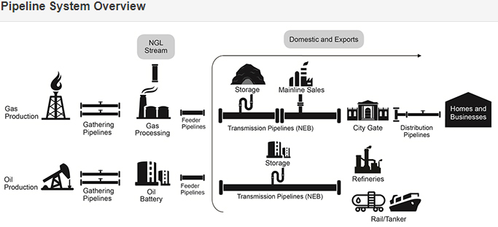
Canada’s pipeline transport system
Pipeline
Images
This is where liquid and gaseous products are transported through pipes
There are 4 main pipeline systems
Gathering pipelines
Feeder pipelines
Transmission pipelines
Distribution pipelines
Notes:
This slides is discussing four pipeline systems in Canada. They are as Gathering, Feeder, Transmission, and distribution pipelines.

Slide 5
Benefits and limitation
Benefits
Limitations
pipeline model is advantageous and beneficial to the Canadian economy
they earn revenue to the Government
creating jobs for many Canadians.
are the safest model for transporting natural gas and oil in Canada.
Transport natural gases as oil in large volumes efficiently.
delays are experienced following legal procedure.
accidental leakages, if undetected earlier,
can lead to loss or even cause a fire
Notes:
This slides is discussing benefits and limitation of pipeline models in Canada. Benefits are pipeline model is advantageous and beneficial to the Canadian economy
they earn revenue to the Government
creating jobs for many Canadians.
are the safest model for transporting natural gas and oil in Canada.
Transport natural gases as oil in large volumes efficiently.
. Limitations are delays are experienced following legal procedure.
accidental leakages, if undetected earlier,
can lead to loss or even cause a fire

Slide 6
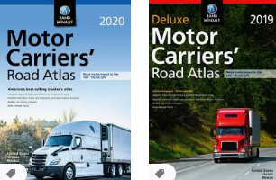
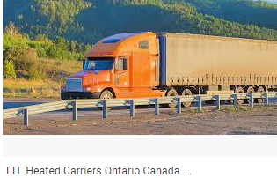
Canada’s Motor carriers
Motor carriers in Canada
Images of motor carriers
motor carriers are used widely in most chains of transport.
It involves the use of small pickup trucks and motor trucks as well as a combination of large tractor-semitrailer.
motor carrier comprises private motor carriers owned by individual firms who lease and operate such trucks.
The motor carriers transport general goods, containers, fuels, gas, and sand in a more secure way
Notes:
This slides introduces us to motor carriers in Canada. They used widely in most chains of transport.
It involves the use of small pickup trucks and motor trucks as well as a combination of large tractor-semitrailer.
motor carrier comprises private motor carriers owned by individual firms who lease and operate such trucks.
The motor carriers transport general goods, containers, fuels, gas, and sand in a more secure way

Slide 7
Benefits and limitations
Benefits
limitations
Has reduced cases of
deaths,
crashes,
injuries
The above incident might results from buses and large commercial trucks
industrial regulations that govern safety in commercial operation ensure safety
safety is ensured to operators and drivers operating commercial vehicles.
their usage is limited by the Motor Vehicle Transport Act (MVTA)
Expensive to buy
maintenance cost is high
Requires professional operators

Slide 8
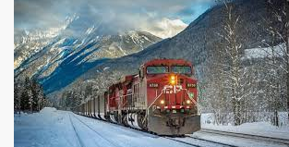
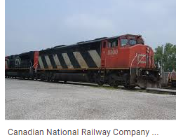
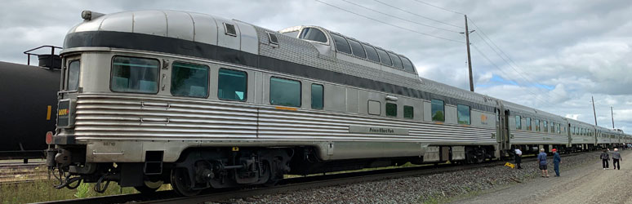
Railroad transport in Canada
Railroad in Canada
Images of Railroad
Railroad transport is a very vital element in the transportation system.
It generates over $ 10 billion every year from the transport industry.
The dominant railroad operators here are Canadian Pacific Railway and Canadian National Railway.
Over 250 million dollars is realized from these freight operators
Canadian National Railway contributes to over 50%
Canadian Pacific Railway accounting to 35%. Collectively,
the two accounts for 85% of revenue annually.
Canadian railroad image
Canadian National Railway

Slide 9
Benefits and limitations
Benefits
limitations
The railroad model in Canada is of benefit
contributes to the growth and development of both the economy and industry.
With the construction of railways in Canada, economic development has improved, opening up more businesses as well as employment creation.
Transport has been revolutionized in Canadian regions
the railroads are limited by inadequate funds
construction cost is high
Maintenance cost is high
Limited to rails only

Slide 10
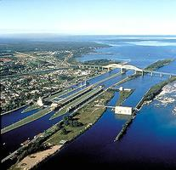
Water carrier in Canada
In Canada, water is a mode of transport, and it involves a couple of vessels moving on the water
This include vessels like ferries, ships, and boats.
The water transport takes place in the form of inland water transportation with and or without ferries.
deep sea, coastal and great lakes water transportation with and without ferries is used.

Slide 11
Benefits and limitation of water carriers
Benefits
limitation of water carriers
The creation of employment stands a key benefit of water carriers’ usage in Canada,
people are offered jobs in Canadian shipbuilders.
As a trading nation, water carriers in Canada cannot be underestimated. The water carriers like the ship are.
It has influenced the free movement of manufactured goods within domestic and international markets
Influence the growth and advance of trade and growth and development of the Canadian economy (Karl, 2015).
the growth, development, and usage of water carriers in Canada can be limited due to the high cost of building water vessels like ships and ferries.
Besides, the water carriers serve those areas where there are waterways only.

Slide 12
Conclusion
the Canadian transport system, Motor carriers, Railroads, airlines, Water carriers, and pipelines are the most common models of transport
Are used in the transportation of both cargo and passengers from point to another.
They play a very critical role in the Canadian economy.
These models support development and advancement in trade and industrialization.
Besides, all the models of transport contribute to the creation of employment in different areas.
However, development and usage may be limited due to the high cost of constructing the unit of carriage as it requires substantial investment.
Some models are limited to areas served with water only.
other models like railroads cannot be used where there are no rails.

Slide 13
References
Air Transportation-Transport Canada. (2020). Retrieved 23 April 2020, from https://www.tc.gc.ca/eng/policy/anre-menu-3018.htm
Conboy. A. (A2013). Air Transport Industry. https://www.thecanadianencyclopedia.ca/en/article/air-transport-industry
Mazarine. E. (2020). Air Canada -operating revenue 2013-2019. https://www.statista.com/statistics/542775/operating-revenue-of-air-canada/
NEB (2020. Canada’s Pipeline Transportation System 2016 - Canada's Pipeline Transportation System. Cer-rec.gc.ca. (2020). Retrieved 23 April 2020, from https://www.cer-rec.gc.ca/nrg/ntgrtd/trnsprttn/2016/cnds-ppln-trnsprttn-systm-eng.html.
https://www.iiste.org/Journals/index.php/CER/article/view/48663. (2019). https://doi.org/10.7176/ceis/11-6-06
Motor Carriers, Commercial Vehicles, and Drivers - Transport Canada. Tc.gc.ca. (2020). Retrieved 23 April 2020, from https://www.tc.gc.ca/eng/motorvehiclesafety/roadsafety-motor-carriers-commercial-vehicles-drivers-1312.htm.
James H. Marsh. (2015). Railway History. https://www.thecanadianencyclopedia.ca/en/article/railway-history
Karl M. Ruppenthal. (2015). Transportation. https://www.thecanadianencyclopedia.ca/en/article/transportation

